Slide 1

CS2009 Design and Analysis of Algorithms
Dijkstra’s Algorithm

Slide 2
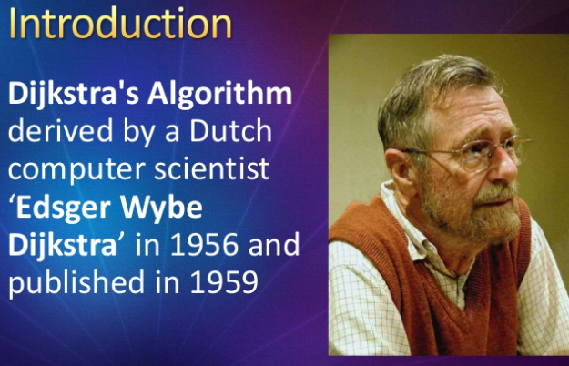
Dijkstra Algorithm

Slide 3
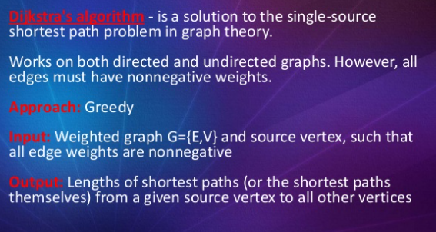
Dijkstra Algorithm

Slide 4
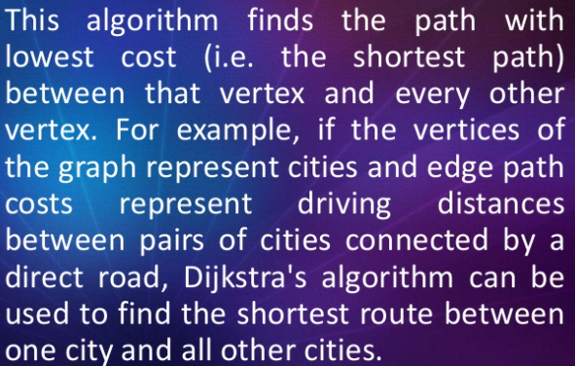
Dijkstra Algorithm

Slide 5
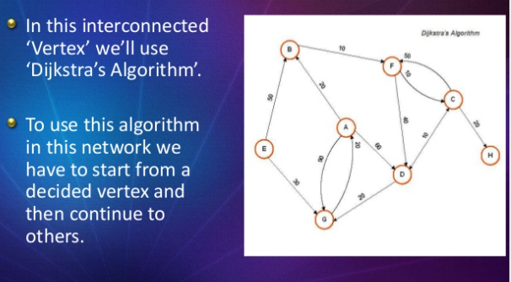
Dijkstra Algorithm

Slide 6

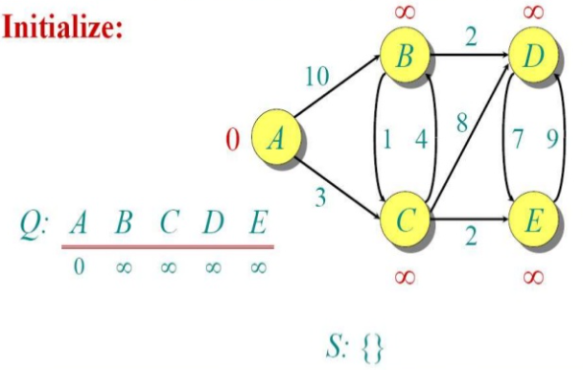
Dijkstra Algorithm

Slide 7
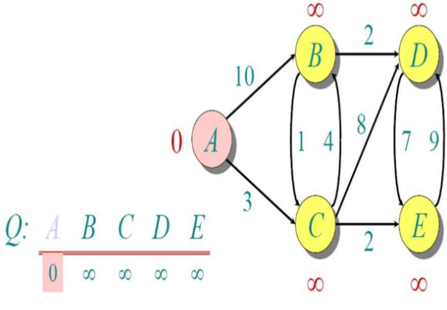
Dijkstra Algorithm

Slide 8
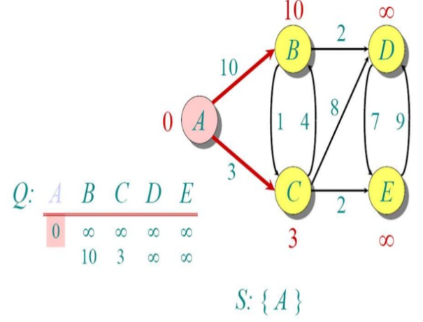
Dijkstra Algorithm

Slide 9
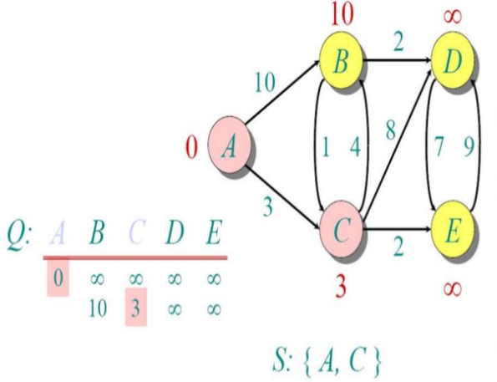
Dijkstra Algorithm

Slide 10
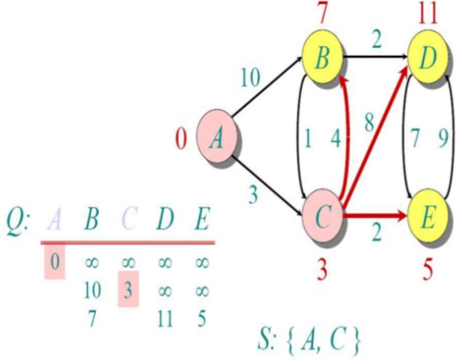
Dijkstra Algorithm

Slide 11
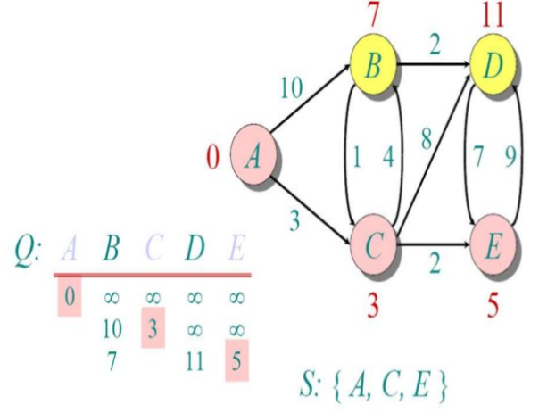
Dijkstra Algorithm

Slide 12
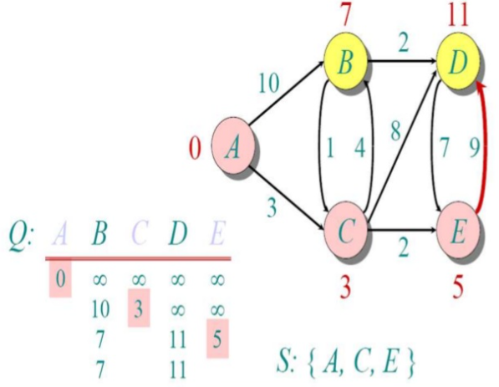
Dijkstra Algorithm

Slide 13
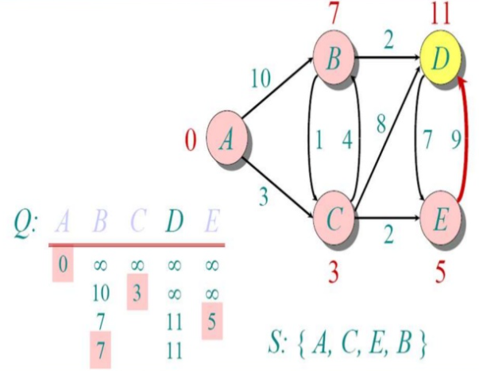
Dijkstra Algorithm

Slide 14
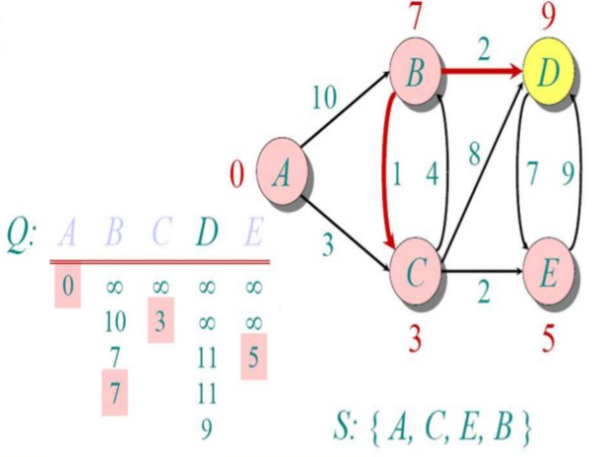
Dijkstra Algorithm

Slide 15
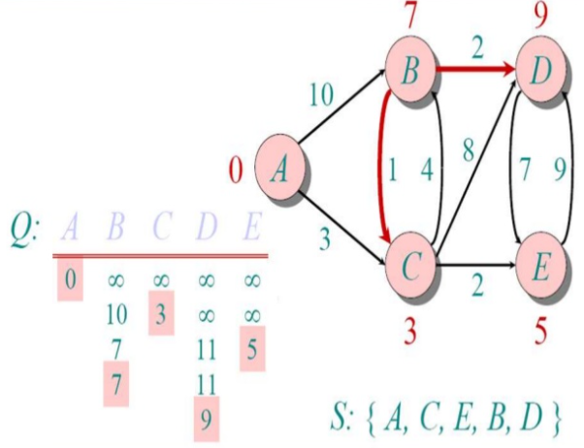
Dijkstra Algorithm

Slide 16
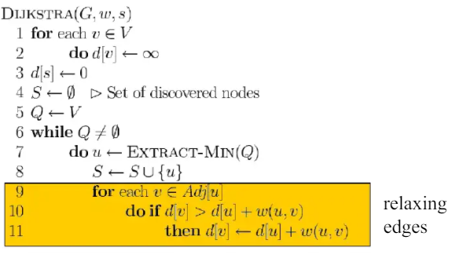
Dijkstra Algorithm
Pseudocode :

Slide 17
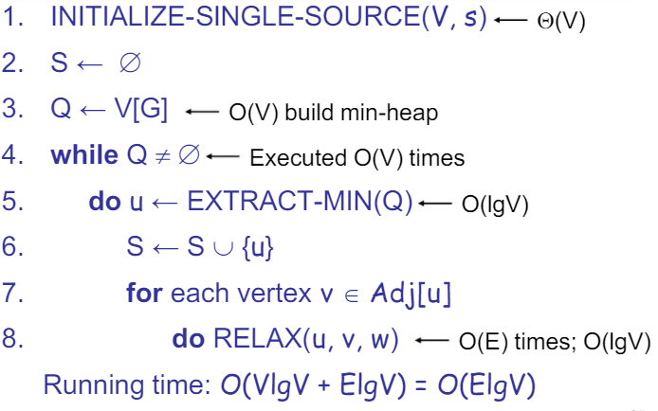
Dijkstra Algorithm

Slide 18
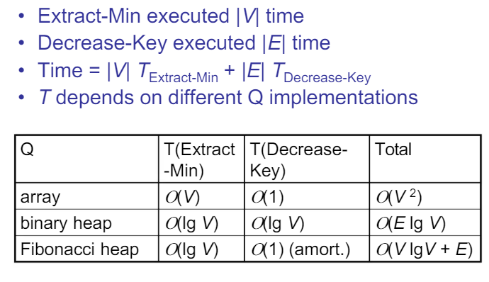
Dijkstra Algorithm

Slide 19
Dijkstra Algorithm
Disadvantages :
Not good for finding shortest path in graphs having negative edges.

Slide 20
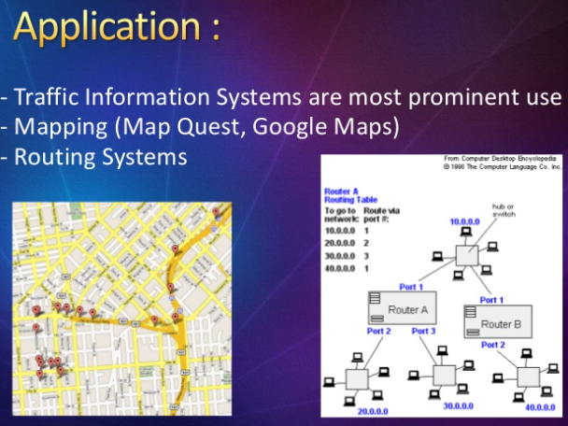
Dijkstra Algorithm

